Slide 1
Azure Functions: no server needed
Mykhail Galushko
Co-founder DevRain Solutions & Avantime Ukraine

Slide 2
The “Evolution” of Application Platforms
On Premises
IaaS
PaaS
Serverless

Slide 3


input
code
output

Slide 4
“Function App” is a group of functions
“Function App”
foo()
bar()
foobar()

Slide 5



Key features
Inherit from / Build on top of App Services
Full control of dependencies and connectors
Develop Functions in C#, Node.js, F#, Python, PHP, Batch and more
Choose from a wide variety of triggers
Expose Functions as HTTP API endpoints
Scale Functions based on customer demand
Easily schedule event-driven tasks across services
Open source
Code
Azure Functions
Events + data

Slide 6







Azure Functions overview
Serverless
Accelerate development
Bind into services
Azure Service Bus
Azure Event Hub
Azure Storage
</>
Dropbox
Sendgrid
AzureDocDb
Event-driven scale
Reduced Dev Ops
Develop your way
Local development
OneDrive
Box
Twilio

Slide 7
Benefits
On demand resources & scaling
Reduced Devops
Focus on business logic
Micro-pricing

Slide 8
Why?
Stateless => Scale
Not worth deploying a traditional backend
Workload is sporadic (very low & high scale)
Lots of different services involved

Slide 9
Supported SKUs for Azure Functions
Consumption Plan
Pay for what you use (execution time, memory)
Platform responsible for scale
App Service Plan
Pay based on # of reserved VMs
Basic, Standard, Premium
You’re responsible for scale (can use autoscale)

Slide 10
Consumption Plan Scaling
Azure Functions will:
Monitor incoming events/traffic
Monitor how much resources/work each of your functions is taking
Horizontally scale your app onto additional VMs as required

Slide 11
Consumption Plan Pricing
Pay per execution model
Executions = Number of executions
GB-sec = Duration of execution x memory usage
Free
1,000,000 free executions
400,000 free GB-sec

Slide 12
Azure Functions architecture
Built on top of App Service and WebJobs SDK
Code
Config
Language Runtime C#, Node.js, F#, PHP, etc.
WebJobs Script Runtime Azure Functions Host – Dynamic Compilation, Language abstractions, etc.
WebJobs Core
Programming model, common abstractions
WebJobs Extensions
Triggers, input and output bindings
App Service Dynamic Runtime Hosting, CI, Deployment Slots, Remote Debugging, etc.

Slide 13
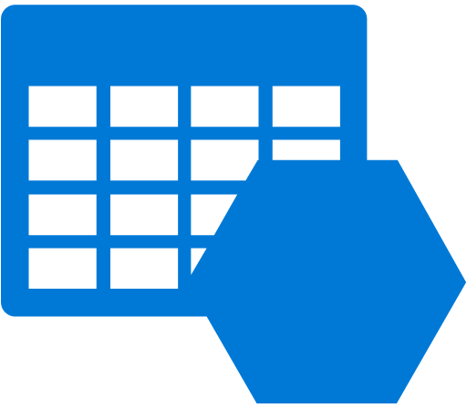




















Building Serverless Apps on Azure
Functions
Logic App
Storage
Media Services
Cortana
Management Suite
Traffic Manager
Document DB
CDN
Machine Learning
OMS
Management Suite
Visual Studio
Services
Search
Active Directory
Key Vault
App Insights
Cognitive Services
Embedded Power BI
Scheduler
IoT Hub
Service Bus
Notification Hub
Stream Analytics
Hockey App

Slide 14
Develop in the cloud or locally
Powerful developer portal
Write code in the cloud
Easily connect to other Azure Services
Execute and test in the portal
Develop locally
Local developer tools integrate with Visual Studio and VS Code
Debug C# Functions in Visual Studio – both local and remote debugging!
Debug JavaScript functions locally in VS Code
Build complex applications with shared libraries or precompiled assemblies

Slide 15
Scenarios
Timer-based processing
Azure service event processing
SaaS event processing
Serverless web application architectures
Serverless mobile backends
Real-time stream processing
Real-time bot messaging

Slide 16
Scenario: incoming data processing
Every 1 mins: incoming HTTP request
Sends data to Blob storage
Sends data to event hub
Worker: processes data from event hub, sends push notifications

Slide 17
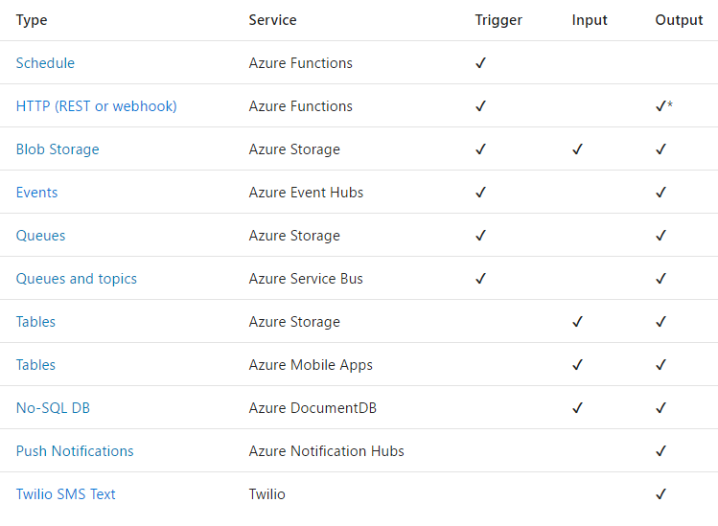
Triggers and Bindings
Triggers
and
Bindings

Slide 18
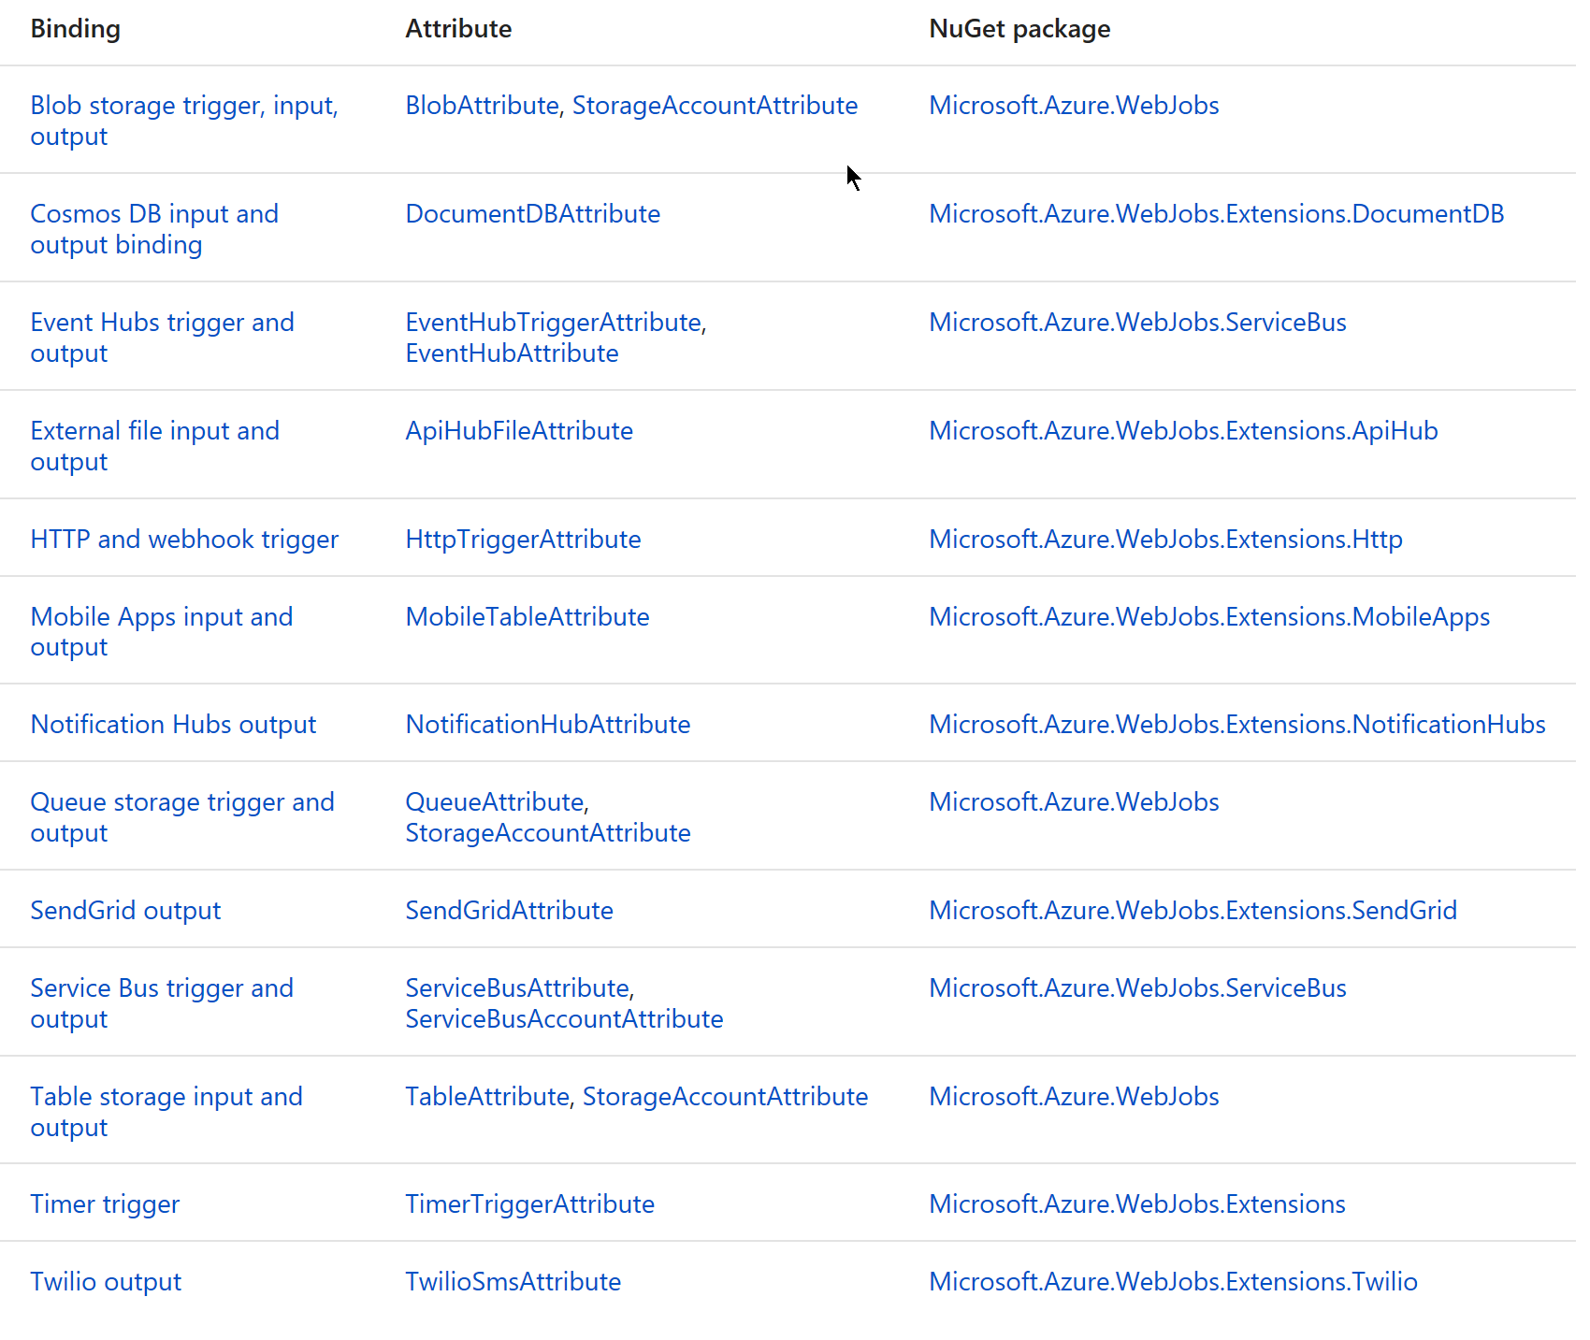
WebJob Bindings

Slide 19
Use Bindings in Your Code
public static class OrderHandler
{
[FunctionName("OrderWebhook")]
public static async Task<HttpResponseMessage> Run(
[HttpTrigger] HttpRequestMessage req,
[Queue("aievents1", Connection = "AiStorageConnection")] IAsyncCollector<String> eventOutput,
TraceWriter log)
{
log.Info($"Webhook was triggered!");
string jsonContent = await req.Content.ReadAsStringAsync();
dynamic data = JsonConvert.DeserializeObject(jsonContent);
await eventOutput.AddAsync(
JsonConvert.SerializeObject(GetLogData(data)));
int orderId = PlaceOrder(data);
return req.CreateResponse(HttpStatusCode.OK,
new {orderNumber = orderId });
}
. . .
}
"bindings": [
{
"type": "httpTrigger",
"direction": "in",
"webHookType": "genericJson",
"name": "req"
},
{
"type": "http",
"direction": "out",
"name": "res"
},
{
"type": "queue",
"name": "eventOutput",
"queueName": "aievents1",
"connection":"AiStorageConnection",
"direction": "out"
}
]

Slide 20
“Functions” programming model
Function as the unit of work
Functions are executed; they start and finish
Functions have inputs and outputs

Slide 21
Best practices
Functions should “do one thing”
Functions should finish as quickly as possible
Functions should be idempotent
1

Slide 22
Functions vs WebJobs
Similar features
Depends on execution time and consuming of memory
Long running functions (more than 5 mins) requires App Service Plan

Slide 23
Function structure
A “Run” file that containing the function code
A “Function” file containing all service and trigger bindings and parameters
A “Project” file containing project assembly and NuGet package references
App Service settings, such as connection strings and API keys
code
Executable code
Function configuration
.NET Core and Project references

Slide 24
Testing
Command-line tools
Tools like Postman and Swagger
Direct web calls via url
Microsoft Azure Storage Explorer
Visual Studio Cloud Explorer

Slide 25
DEMO

Slide 26
Q&A
mykhail.galushko@devrain.com

